Slide 1
THE POWER OF PINNACLE SERIES
AN INTRODUCTION

Slide 2
AGENDA
Introductions
Why Pinnacle Series?
Pinnacle Series Overview
Pinnacle Series Subscription
Question & Answer
Next Steps
Mike Lyons
Business Development Manager
Steve Biver
Director of Solution Development

Slide 3
WHO IS EAGLE POINT SOFTWARE?
Been in business since 1983
A company of Architects, Engineers, Construction Managers, Customer Success Managers, and Developers
Pinnacle Series born in 2006
275,000+ users in Pinnacle Series
30+ year member of Autodesk Developer Network (ADN)
Autodesk Authorized Publisher
Global Partner Network

Slide 4
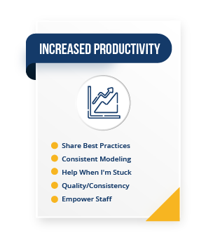
WHY PINNACLE SERIES?

Slide 5
CONTINUOUS LEARNING
In 2018, 70% of employees said they didn’t have mastery of the skills they need to do their jobs. ¹
A stunning 93% of Millennials consider skill development and learning a crucial aspect of their career path.²
87% of executives said they’re experiencing skills gaps in the workforce or are anticipating them in coming years.³
59% of companies state that their workforce doesn’t have the skills needed to work with BIM.⁴

Slide 6
KNOWLEDGE CAPTURE & SHARING
72% of execs said workers’ ability to assume new roles is essential to navigating disruptions like COVID-19 – but only 17% said their organizations were prepared to adapt and reskill workers.⁵
55% of employees said organizational silos are a barrier to effective knowledge management at their company.⁶
The estimated cost of knowledge lost from employee turnover can range from 33% to 200% of the departing employee’s salary. For an employee making $70,000 per year, that’s $140,000 of knowledge lost!⁷

Slide 7
INCREASED PRODUCTIVITY
More than 60% of knowledge workers must access 4 or more systems each day to find what they need to do their jobs.⁸
85% of employees report that they’re not engaged or are actively disengaged at work, resulting in $7 trillion in lost productivity.⁹
92% of employees said having access to technology that helps them do their jobs more efficiently positively affects their work satisfaction.¹⁰

Slide 8
PINNACLE SERIES DEMONSTRATION

Slide 9
PINNACLE SERIES SUBSCRIPTION MODEL
Global Enterprise Subscription - Unlimited Employee Access
Choose the Asset Libraries
Content available in over 90 languages
Robust Report Dashboard
Unlimited Windows Azure Cloud Storage
Content Customization
Active Directory Integration Including SSO
Open API for Content Development
Implementation Plan Executed by Customer Success Team
Plus, much more!

Slide 10
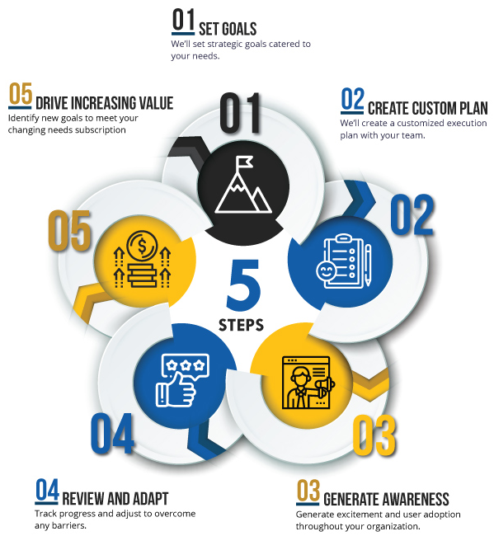
PINNACLE SERIES IMPLEMENTATION & CUSTOMER SUCCESS
Proven Success
YTD Renewal Rates
99%

Slide 11
QUESTIONS?

Slide 12
THANK YOU!

Slide 13
A FEW EXISTING PINNACLE CLIENTS
AFRY
AKF Group
American Structurepoint
BECA
BlueScope Steel
Capita
Cardno
CDI
CDM Smith
CHA
CIMA+
David Evans & Associates
Gannett Fleming
GHD
Golder Associates
Hassell
HDR
Heijmans
HKS
HNTB
IA Interior Architects
IBI Group
Johnson, Mirmiran & Thompson

Slide 14
A FEW EXISTING PINNACLE CLIENTS (continued)
KPF
Leo A Daly
McCarthy Holdings
Michael Baker International
Middough Associates
Mott McDonald
MultiConsult
Nelson
Olsson
Parker Hannifin Corporation
Parsons
Psomas
Royal Haskoning
Siemens
Skanska
Stanley Consultants
Surveying & Mapping
Tetra Tech
TRC Companies
Vanasee Hangen Brustlin
WSP
Plus thousands more…..

Slide 15
OUR STAFF
John Biver
President & CEO
Steve Biver
Director of Solution Development
Tanson Bothe
Product Designer / Platform Development
Dolly Burke
Customer Success Manager
Chad Close
Building Technology Manager

Slide 16
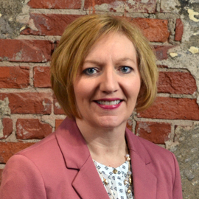
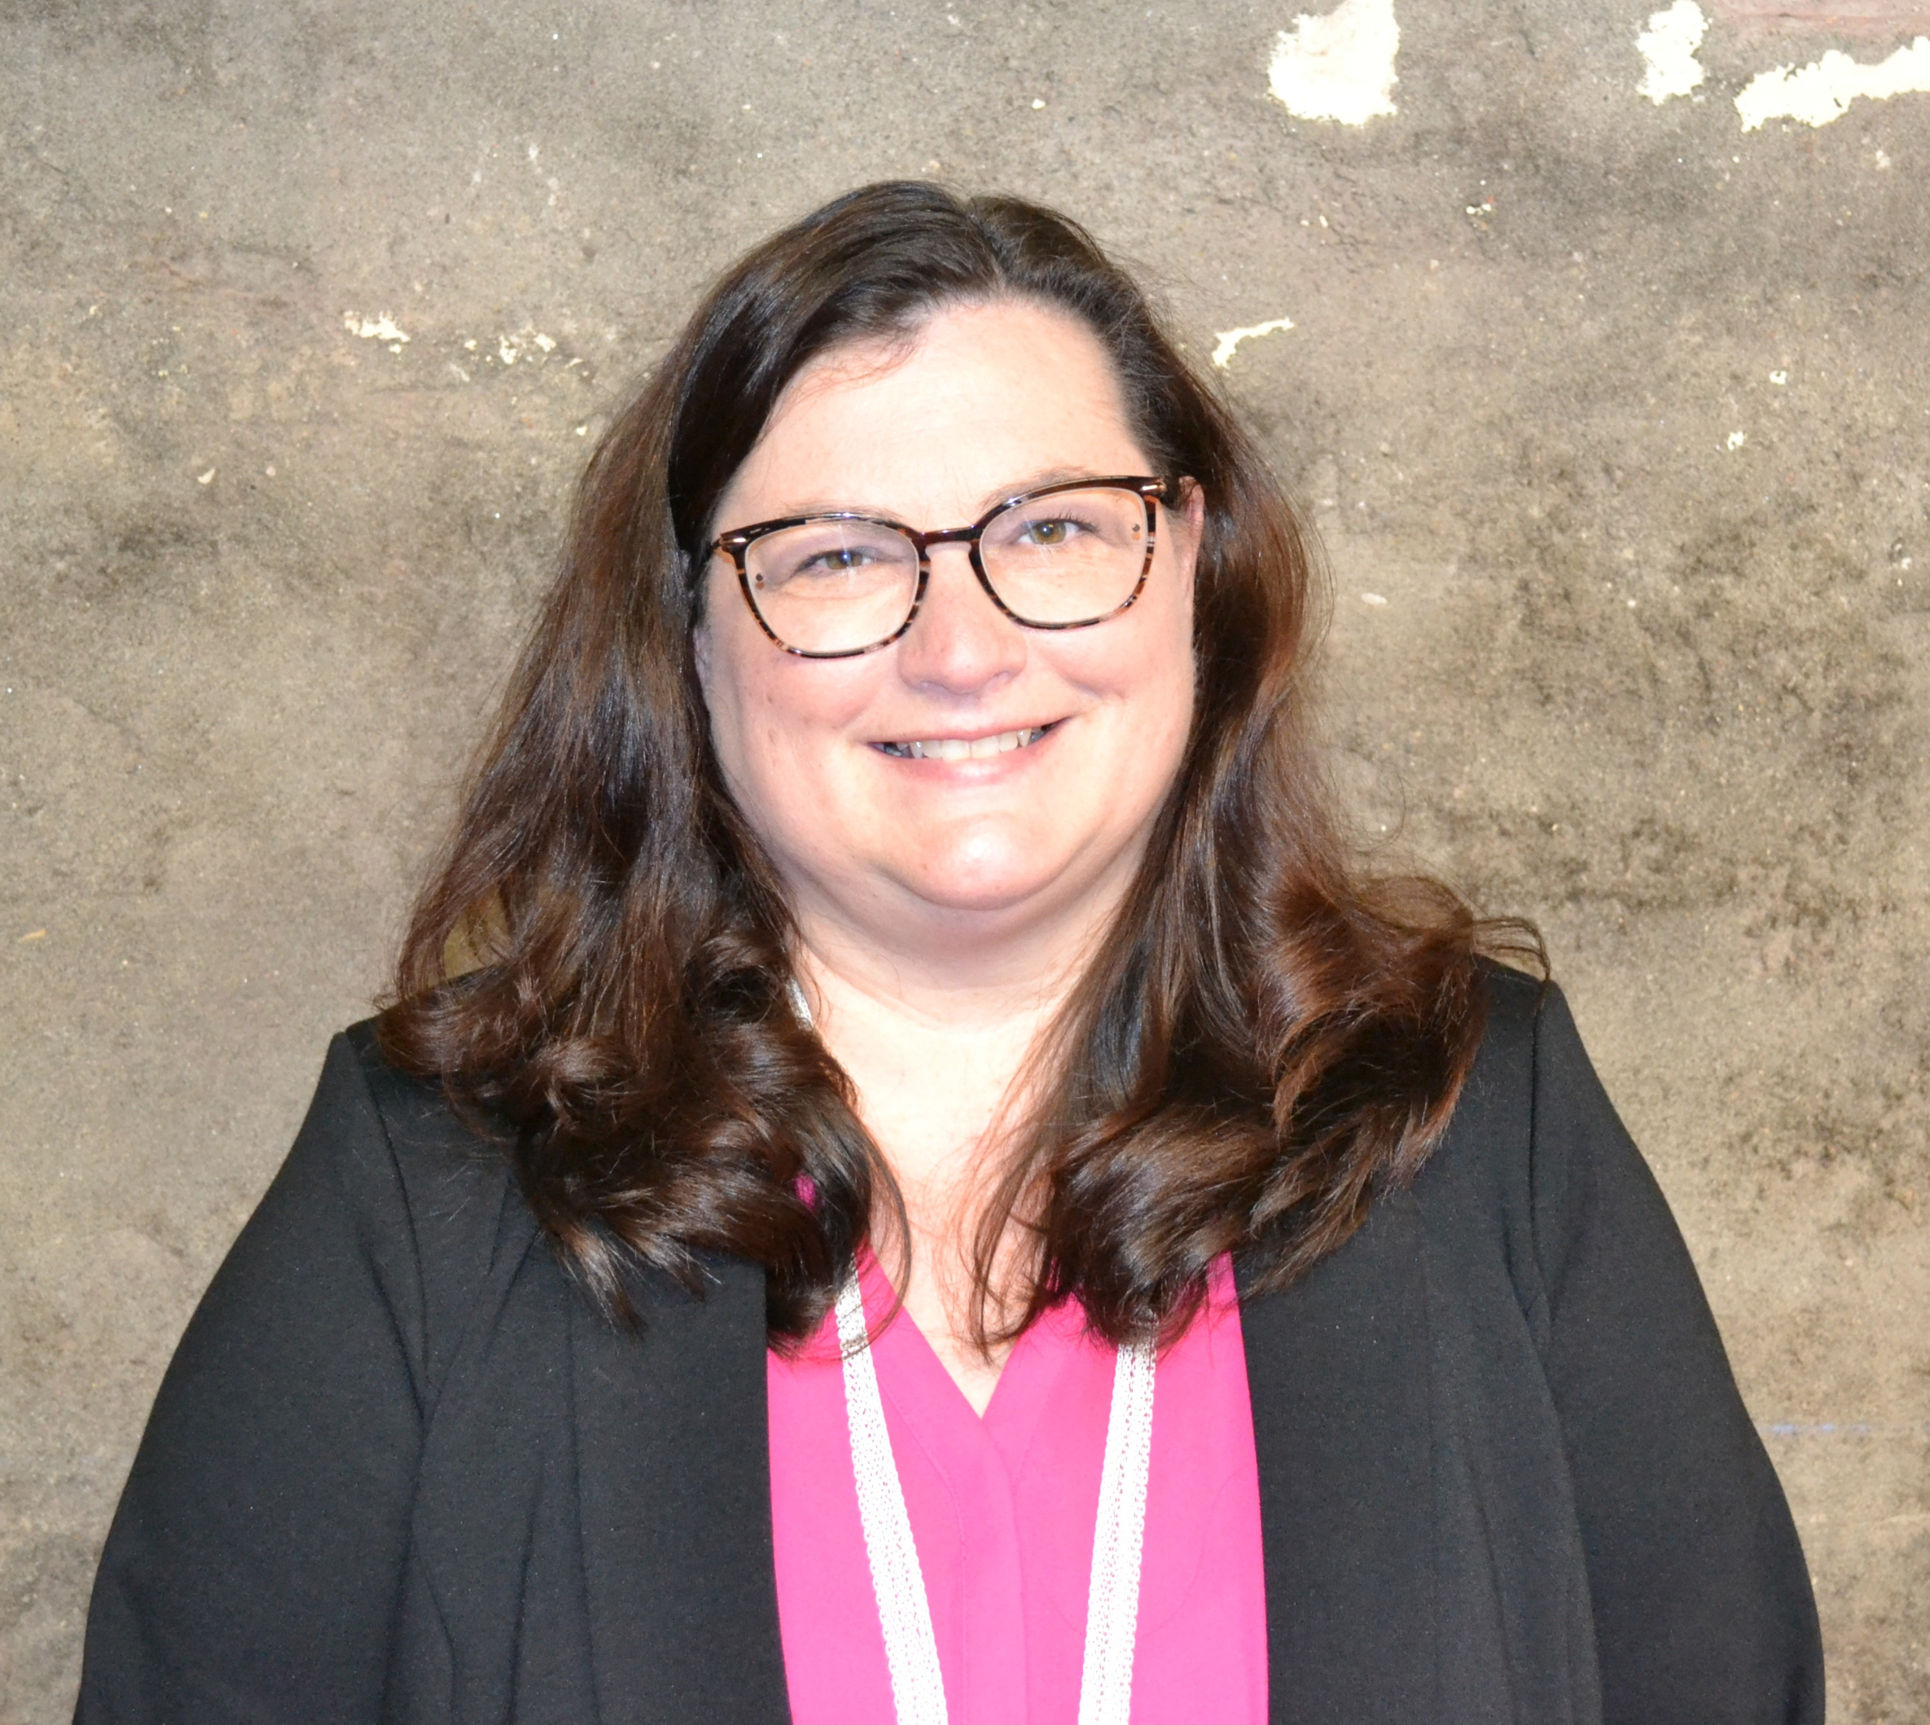
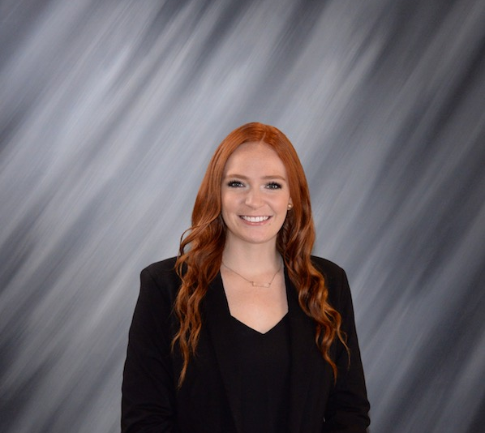
OUR STAFF
Dan Craig
Customer Success Specialist
Mike Federspiel
Customer Success Specialist
Mary Forbes
Customer Success Manager
Lisa Gurman
Customer Success Manager
Elizabeth Herzmann
HR Generalist

Slide 17
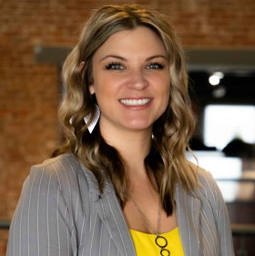
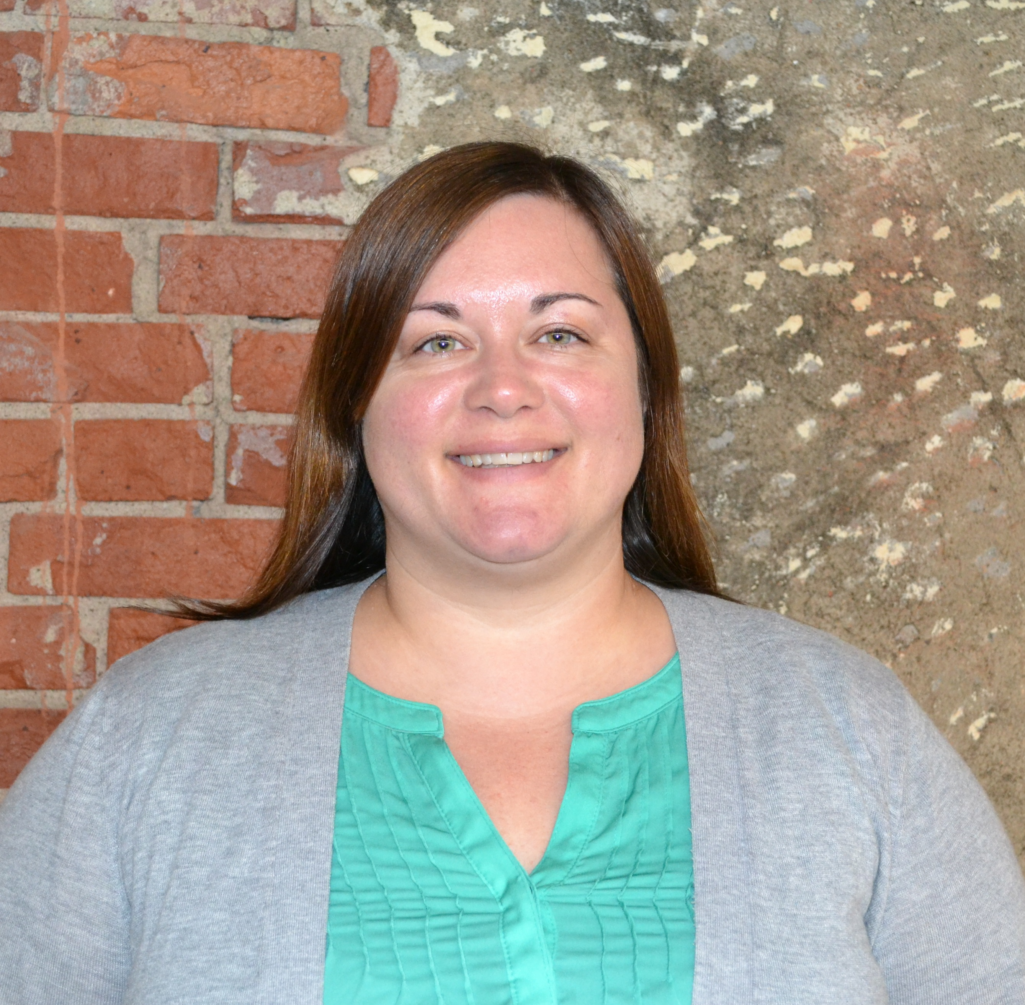
OUR STAFF
William Hirsch
Partner Manager
Bianca Holtier Coury
Construction Technology Manager
Katy Jones
Customer Success Manager
Steve Link
Business Development Manager
Katie Lau
Customer Success Specialist

Slide 18
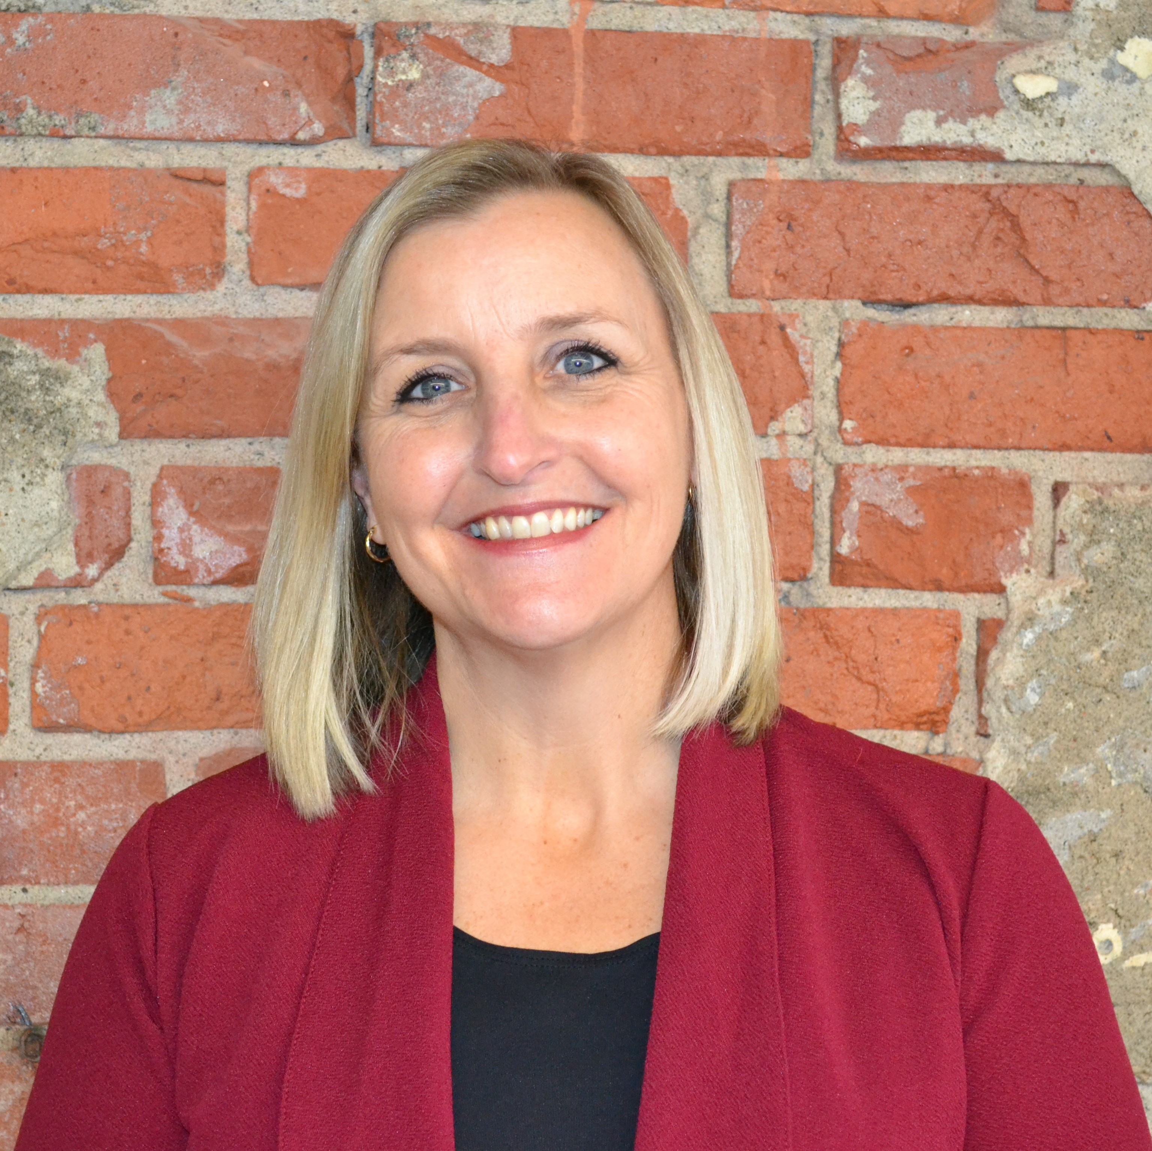
OUR STAFF
Haley Lundgren
Customer Success Manager
Mike Lyons
Business Development Manager
Jill Meloy
Customer Success Manager
Jake Meyer
Business Development Manager
Margaret O’Reilly
Customer Success Manager

Slide 19
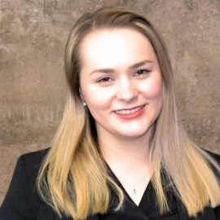
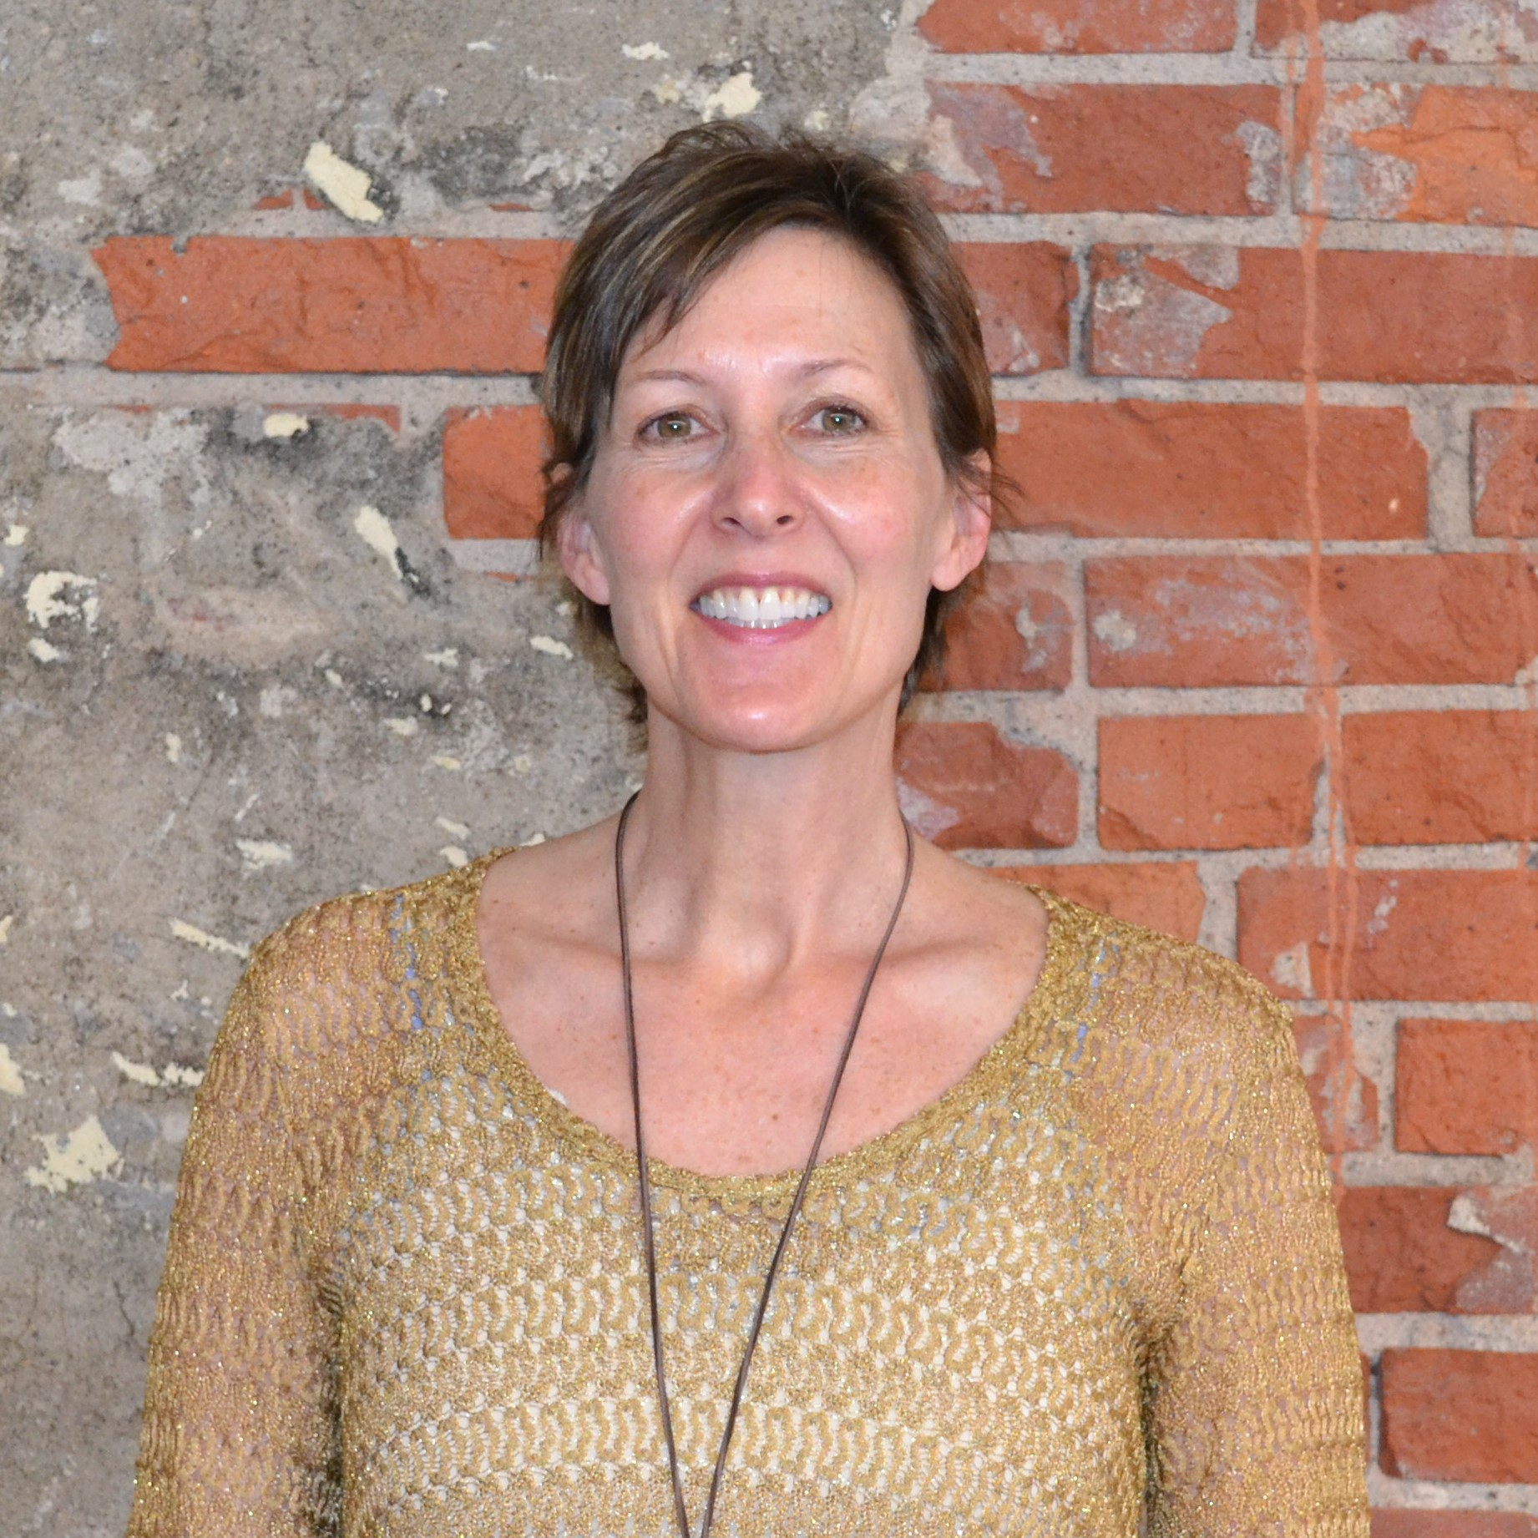
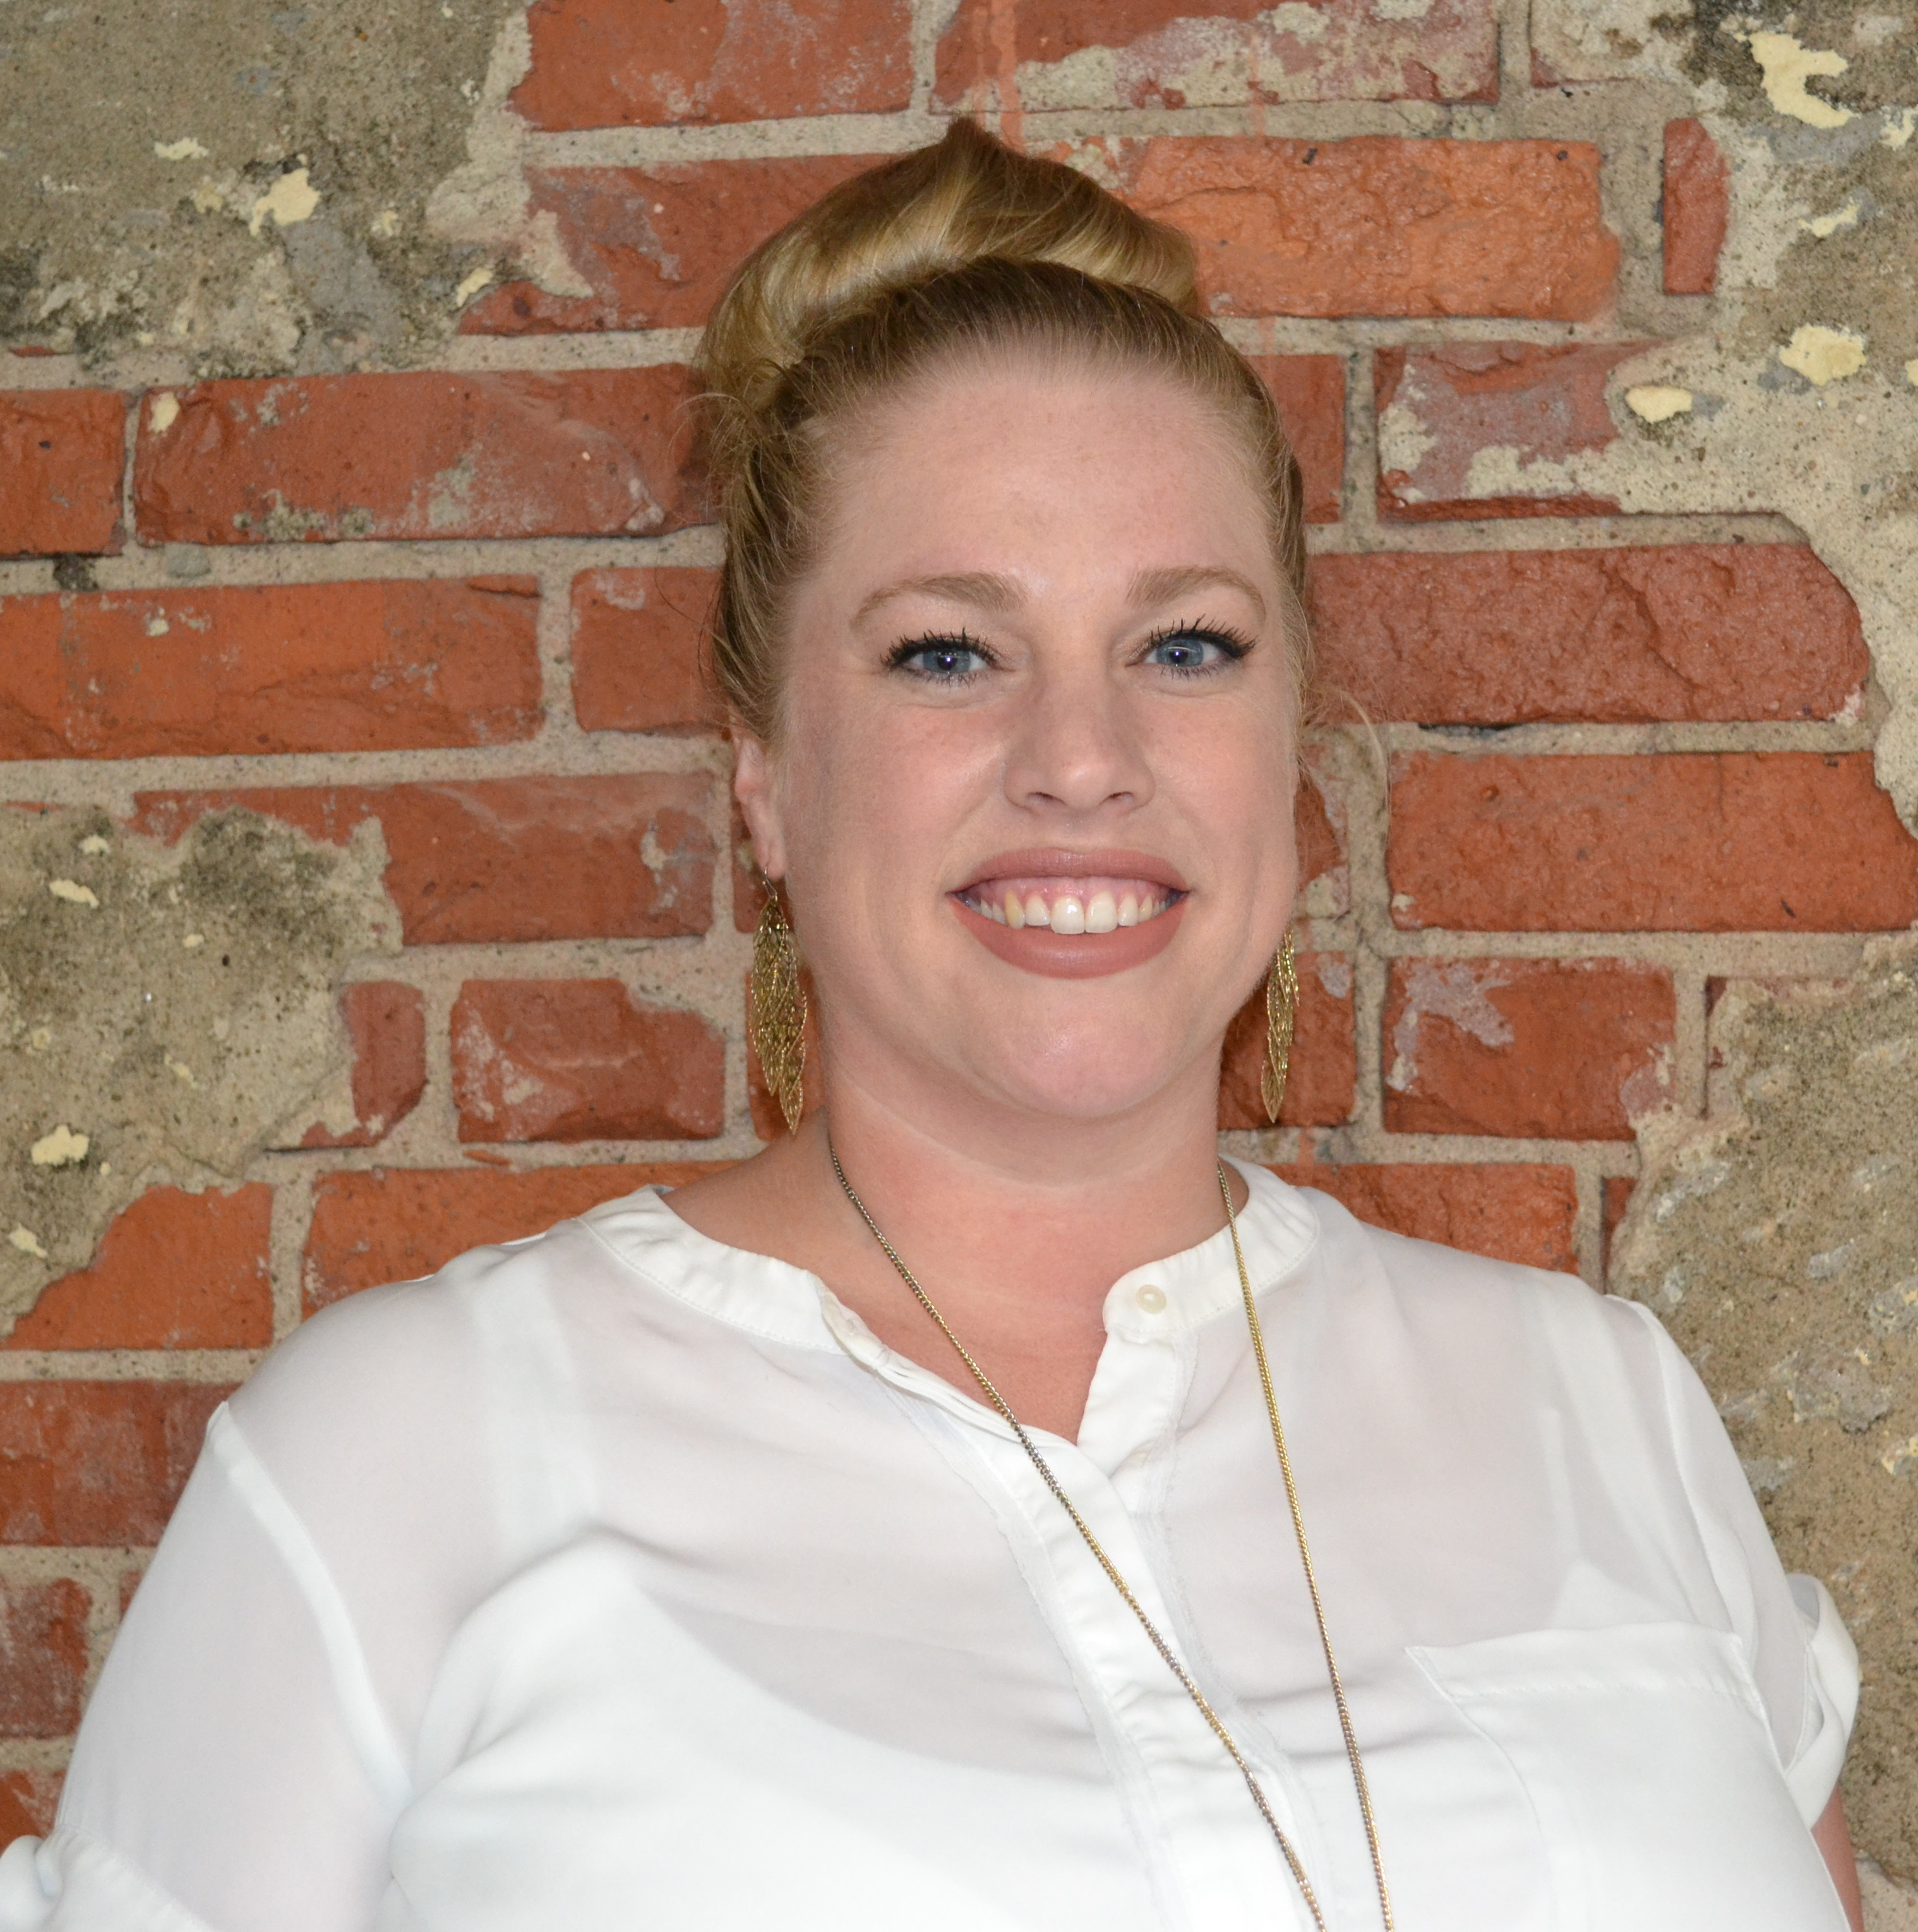
OUR STAFF
Rose Otto
Partner Manager
Don Quinn
Civil Technology Manager
Renee Riffey
Customer Success Manager
Nicole Ruchotzke
Customer Success Specialist
Carole Shutts
Customer Success Manager

Slide 20
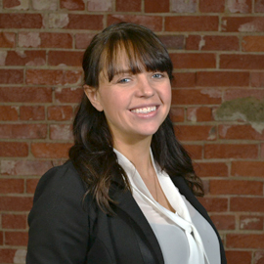
OUR STAFF
Lisa Taylor
Customer Success Manager
Rory Vance
Customer Support Team Lead
Amanda Wachendorf
Customer Success Team Lead
Alec Zamora
Partner Manager

Slide 21
OUR PARTNERS

Slide 22
OUR PARTNERS

Slide 23
OUR PARTNERS

Slide 24
SOURCES
¹ https://www.gartner.com/en/human-resources/role/learning-development
² https://goremotely.net/blog/millennials-in-the-workplace/
³ https://chiefexecutive.net/closing-the-tech-skills-gap-3-key-factors-for-ceos-to-consider/
⁴ https://constructionblog.autodesk.com/bim-strategy/
⁵ https://www2.deloitte.com/content/dam/insights/us/articles/6935_2021-HC-Trends/di_human-capital-trends.pdf
⁶ https://www2.deloitte.com/us/en/insights/focus/human-capital-trends/2020/knowledge-management-strategy.html
⁷ https://devada.com/expert-tips-how-to-ease-the-cost-of-knowledge-loss-from-employee-turnover/#:~:text=According%20to%20recent%20data%20from,can%20be%20calculated%20at%20%24100%2C000!
⁸ http://pages.coveo.com/rs/coveo/images/IDC-Coveo-white-paper-248821.pdf
⁹ https://www.gallup.com/workplace/231668/dismal-employee-engagement-sign-global-mismanagement.aspx
¹⁰ https://www.ultimatesoftware.com/happywork

Slide 25
ACCESS PINNACLE ANYWHERE
Work
Home
Mobile

Slide 26
WHAT’S NEXT
Complete Pinnacle Series Browser Learning Path
Review Public content
Download the Pinnacle User Tools from Software Center

