Slide 1
THE POWER OF PINNACLE SERIES
AN INTRODUCTION

Slide 2
AGENDA
Introductions
Why Pinnacle Series
Pinnacle Series Overview
Pinnacle Series Subscription
Q&A
Mike Lyons
Business Development Manager – Major Accounts

Slide 3
WHO IS EAGLE POINT SOFTWARE?
Been in business since 1983
A company of Architects, Engineers, Construction Managers, Customer Success Managers, and Developers
Pinnacle Series born in 2006
200,000+ users in Pinnacle Series
30+ year member of Autodesk Developer Network (ADN)
Autodesk Authorized Publisher
Global Partner Network

Slide 4
WHY PINNACLE SERIES?
Continuous Learning
Knowledge Capture & Sharing
Increased Productivity
Onboarding New People
Technology Training
Target Specific Skills Gaps
Adopting New Technology
Capture Best Practices
Standards
Company Procedures
Workflows
Share Best Practices
Consistent Modeling
Help When I’m Stuck
Quality/Consistency
Empower Staff

Slide 5
CONTINUOUS LEARNING
In 2016, 68% of workers say training and development is the most important workplace policy.
A whopping 87% of Millennials say that professional development and career growth are significant to them.
70% of CEOs say their organization doesn’t have the skills to adapt to disruptive changes due to technology advances.
59% of companies state that their workforce doesn’t have the skills needed to work with BIM.
Continuous Learning
Onboarding New People
Technology Training
Target Specific Skills Gaps
Adopting New Technology

Slide 6
KNOWLEDGE CAPTURE & SHARING
It’s estimated that poor knowledge-sharing practices cost Fortune 500 companies $31.5 billion annually.
74% of organizations estimate that effective knowledge management disciplines increase company productivity by 10-40%.
53% of C-suite respondents said the knowledge-related costs of losing key employees falls somewhere between $50K-$299K per employee.
Knowledge Capture & Sharing
Capture Best Practices
Standards
Company Procedures
Workflows

Slide 7
INCREASED PRODUCTIVITY
According to a McKinsey report, employees spend 1.8 hours every day—9.3 hours per week, on average—searching and gathering information.
19.8 percent of business time – the equivalent of one day per working week – is wasted by employees searching for information to do their job effectively.
IDC data shows that “the knowledge worker spends about 2.5 hours per day, or roughly 30% of the workday, searching for information.
Increased Productivity
Share Best Practices
Consistent Modeling
Help When I’m Stuck
Quality/Consistency
Empower Staff

Slide 8
PINNACLE SERIES DEMONSTRATION

Slide 9
PINNACLE SERIES SUBSCRIPTION MODEL
Global Enterprise Subscription - Unlimited Employee Access
Choose the Asset Libraries
Content available in over 60 languages
Robust Report Dashboard
Unlimited Windows Azure Cloud Storage and Content Customization
Plus much more
Implementation Plan Executed by Customer Success Team
Open API for Custom Development
Active Directory Integration Including SSO

Slide 10
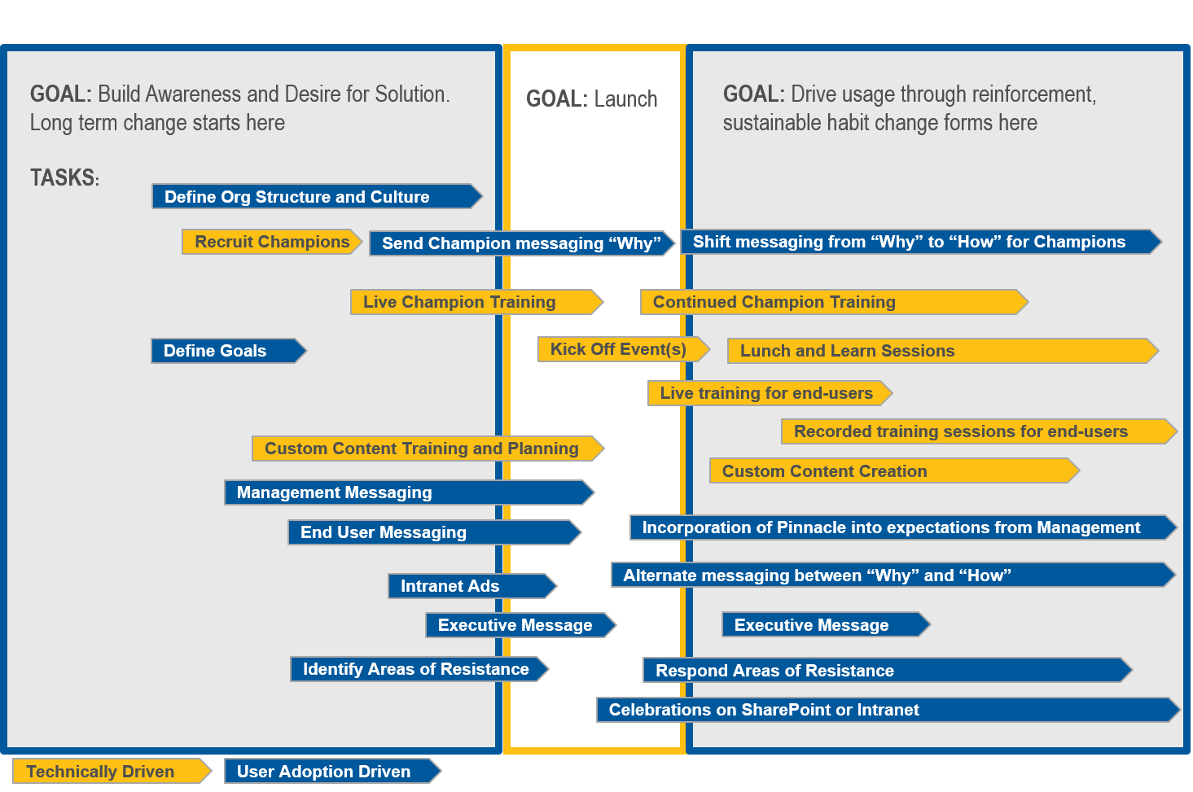
PINNACLE SERIES IMPLEMENTATION & CUSTOMER SUCCESS
Proven Success
YTD Renewal Rates
93.4%

Slide 11
QUESTIONS?

Slide 12
A FEW EXISTING PINNACLE CLIENTS
WSP
Parsons
HNTB
Vanasse Hangen Brustlin
Tetra Tech
Stanley Consultants
Golder Associates
CDM Smith
Brown & Caldwell
Leo A Daly
HKS
Johnson, Mirmiran & Thompson
Surveying & Mapping
Olsson
American Structurepoint
CDI Corporation
Skanska
BlueScope Steel
Capita
CDI
MultiConsult

Slide 13
A FEW EXISTING PINNACLE CLIENTS (continued)
TRC Companies
KPF
Cardno
Nelson
Mott McDonald
Gannett Fleming
Hassell
Middough Associates
AKF Group
HDR
CHA
GHD
BECA
CIMA+
Psomas
IA Interior Architects
David Evans & Associates
Surveying & Mapping
Siemens
Plus Thousands more…..

